Slide 1


Aaron King
September 14, 2023

Slide 2

Outline
Executive Summary …………………..3
Introduction …………………………..4
Methodology …………………………5
Results …………………………….....16
Conclusion …………………………..45
Appendix ……………………………46

Slide 3
Executive Summary
Collected data from public SpaceX API and SpaceX Wikipedia page. Created labels column ‘class’ which classifies successful landings. Explored data using SQL, visualization, folium maps, and dashboards. Gathered relevant columns to be used as features. Changed all categorical variables to binary using one hot encoding. Standardized data and used GridSearchCV to find best parameters for machine learning models. Visualize accuracy score of all models.
Four machine learning models were produced: Logistic Regression, Support Vector Machine, Decision Tree Classifier, and K Nearest Neighbors. All produced similar results with accuracy rate of about 83.33%. All models over predicted successful landings. More data is needed for better model determination and accuracy.

Slide 4
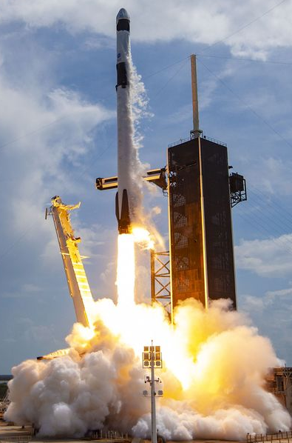
Introduction
Project Background
Space X has best pricing ($62 million vs. $165 million USD that has been the bottom price for sending property into space.)
Largely due to ability to recover part of rocket (Stage 1)
Space Y wants to compete with Space X
Project Problem
Space Y tasks us to train a machine learning model to predict successful Stage 1 recovery
SpaceX’s Falcon 9 rocket launch – Popular Mechanics

Slide 5

Section 1

Slide 6
Methodology
Executive Summary
Data collection methodology:
Combined data from SpaceX public API and SpaceX Wikipedia page
Perform data wrangling
Classifying true landings as successful and unsuccessful otherwise
Perform exploratory data analysis (EDA) using visualization and SQL
Perform interactive visual analytics using Folium and Plotly Dash
Perform predictive analysis using classification models
Tuned models using GridSearchCV

Slide 7
Data Collection
Data collection process involved a combination of API requests from Space X public API and web scraping data from a table in Space X’s Wikipedia entry.
Space X API Data Columns:
FlightNumber, Date, BoosterVersion, PayloadMass, Orbit, LaunchSite, Outcome, Flights, GridFins, Reused, Legs, LandingPad, Block, ReusedCount, Serial, Longitude, Latitude
Wikipedia Webscrape Data Columns:
Flight No., Launch site, Payload, PayloadMass, Orbit, Customer, Launch outcome, Version Booster, Booster landing, Date, Time
The following slides will cover the flowchart of data collection from API and the process for webscraping.

Slide 8
Data Collection – SpaceX API
Request from SpaceX API
.JSON file and the lists created
.JSON normalized to DataFrame
Filtered Dictionary Relevant Data
Dictionary DataFrame Created
Filtered Data to Falcon 9 launches
Replaced PayloadMass values with Mean
- GitHub URL: https://github.com/AKingSolutions/IBM-Data-Science-Certification-Capstone/blob/737a64639bd997b816d3920e24b790664017f322/Lab%201%20-%20Data%20Collection.ipynb

Slide 9
Data Collection - Scraping
Request Wikipedia HTML
BeautifulSoup
html5lib Parser
Locate Launch Info Table within HTML
Create Dictionary
Iterate through table to extract data to dictionary
Dictionary to DataFrame for Processing
- GitHub URL: https://github.com/AKingSolutions/IBM-Data-Science-Certification-Capstone/blob/219da2bd5d59c33814a67e13d68e415af630eb5e/Lab%201%20-%20Webscraping.ipynb

Slide 10
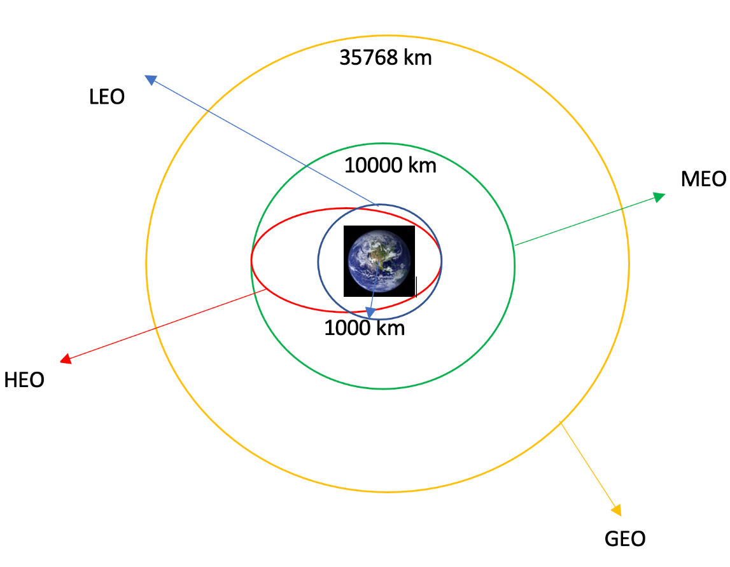
Data Wrangling
Performed exploratory data analysis, determining the training labels for the data sets.
Calculated the number of launches at each site, the number and occurrence of each orbit and launch.
Created landing outcome variables from the outcome data column and exported those results to csv file format for later use.
GitHub URL: https://github.com/AKingSolutions/IBM-Data-Science-Certification-Capstone/blob/a645279fe7da390f0bc7abccda18495178e015a3/Lab%202%20-%20Data%20Wrangling.ipynb

Slide 11
EDA with Data Visualization
Exploratory Data Analysis performed on variables Flight Number, Payload Mass, Launch Site, Orbit, Class and Year.
Plots Used:
Flight Number vs. Payload Mass, Flight Number vs. Launch Site, Payload Mass vs. Launch Site, Orbit vs. Success Rate, Flight Number vs. Orbit, Payload vs Orbit, and Success Yearly Trend
Scatter plots, line charts, and bar plots were used to compare relationships between variables to
decide if a relationship exists so that they could be used in training the machine learning model
GitHub URL: https://github.com/AKingSolutions/IBM-Data-Science-Certification-Capstone/blob/6f3b003b8bbc807304d4d01655910bcd1e50a3aa/Lab%204%20-%20EDA%20with%20Data%20Visualization.ipynb

Slide 12
EDA with SQL
Loaded SpaceX dataset into PostgreSQL database using jupyter notebook.
Analyzed using SQL queries to get insight into the data. The following are some of the queries:
Display the names of the unique launch sites in the space mission
Display the total payload mass carried by boosters launched by NASA (CRS)
Display average payload mass carried by booster version F9 v1.1
List the date when the first succesful landing outcome in ground pad was acheived.
GitHub URL: https://github.com/AKingSolutions/IBM-Data-Science-Certification-Capstone/blob/6f3b003b8bbc807304d4d01655910bcd1e50a3aa/Lab%203%20-%20SQL%20EDA.ipynb

Slide 13
Build an Interactive Map with Folium
Each launch site was marked with a map marker, circles for indicating site location, and then lines were incorporated to pinpoint success and failure of launches for each launch site using the folium map.
By assigning success and failure rates to each launch site, color labeled marker clusters could be assigned to each map launch site to identify the success rate of each launch site.
Finally, distances were calculated relative to launch sites to judge objects within its proximity.
Distance from railways, highways, and coastlines.
Distance from major cities.
GitHub URL: https://github.com/AKingSolutions/IBM-Data-Science-Certification-Capstone/blob/d4436c947916099e27eb3fdda5b84d4672811e1f/Lab%205%20-%20Launch%20Site%20Analysis%20with%20Folium.ipynb

Slide 14
Build a Dashboard with Plotly Dash
Using Plotly Dash, a dashboard was generated to be an interactive design capable of allowing a user to observe different pieces of information on Launch Sites for Space X.
Pie charts were generated showing total launches from each site and giving a comparison to the total launches of all sites.
And finally, a scatter plot was generated showing the relationship between Outcome and Payload Mass for different booster versions. A slide adjustment was added to allow a user to observe the changes between different payload masses.
GitHub URL: https://github.com/AKingSolutions/IBM-Data-Science-Certification-Capstone/blob/1f31c05903f718a027ede2f5d0b1fa06bb2d30c2/SpaceX%20Dashboard%20App.py

Slide 15
Predictive Analysis (Classification)
Split Class Column from Dataset
Fit and Transformed features using Scaler
Train, Test, Split
GridSearchCV set to 10 to find optimal parameters
GridSearch CV applied to LogReg, SVM, Decision Tree, and KVM models
Scored each model on test split sets
Generated Confusion Matrix for all Models
Barplot to compare model scores
GitHub URL: https://github.com/AKingSolutions/IBM-Data-Science-Certification-Capstone/blob/e026d9ea690c5a6f07f409aff84ee602e7cce111/Lab%207%20-%20SpaceX%20Machine%20Learning%20Predictions.jupyterlite.ipynb

Slide 16
Results
The following slides will show the following:
Exploratory data analysis results
Interactive analytics demo in screenshots
Predictive analysis results

Slide 17

Section 2

Slide 18
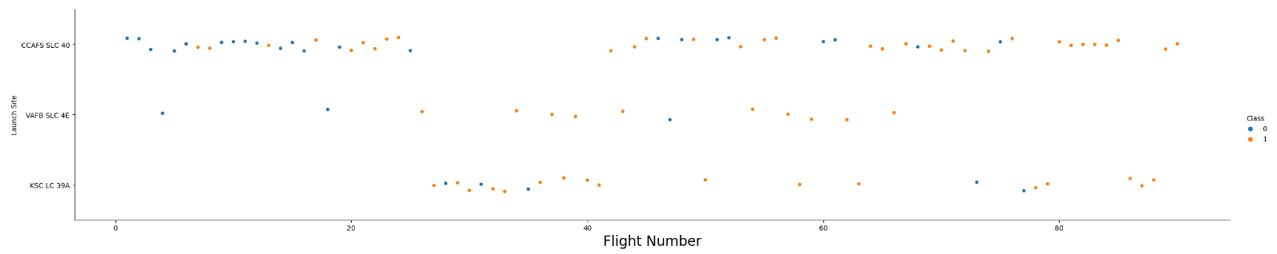
Flight Number vs. Launch Site
Blue indicates unsuccessful launch while orange indicates successful launches.
The graph indicates an increase in success rate over time. As the number of launches increases, the more those launches were written as a success. The graph also seems to indicate that CCAFS SLC 40 launch site is the favored launch site by volume as the majority of launches are performed there.

Slide 19
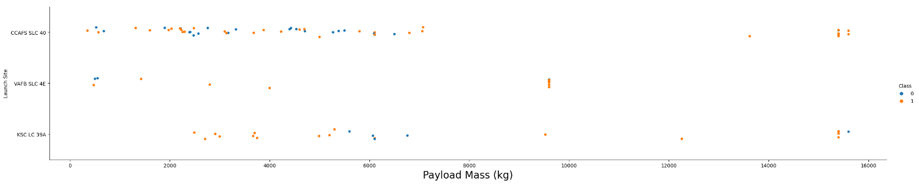
Payload vs. Launch Site
Blue indicates unsuccessful launch while orange indicates successful launches.
Payload mass appears to fall mostly between 0-6000 kg. Different launch sites also seem to use different payload mass.

Slide 20
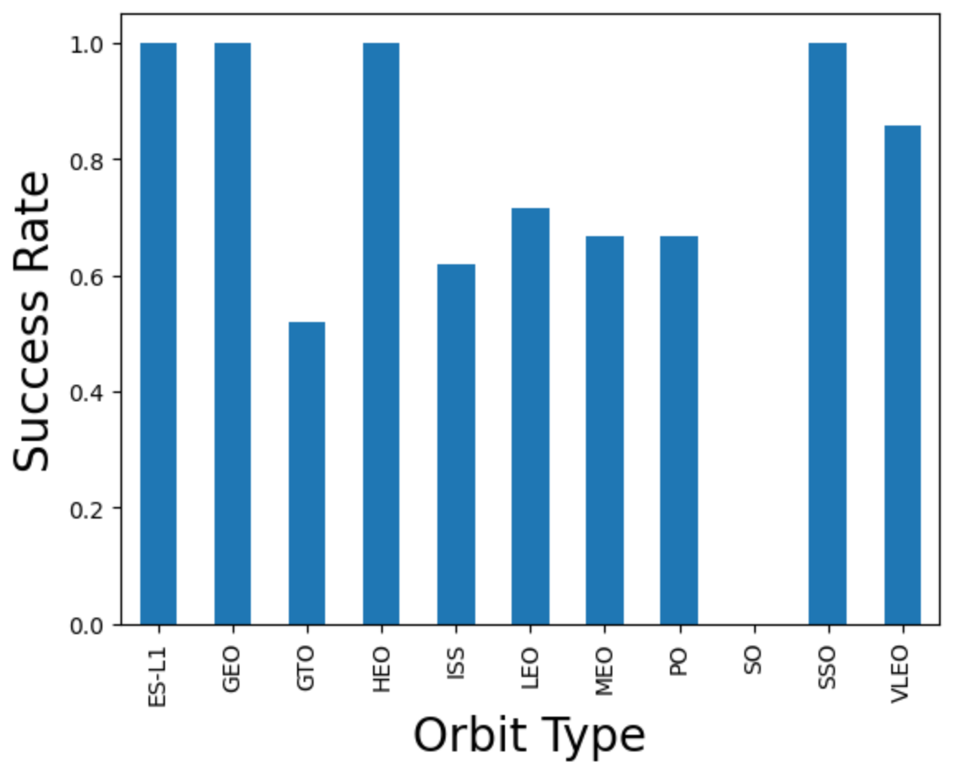
Success Rate vs. Orbit Type
Success Rate of ES-L1, GEO, HEO, SSO are 100%
GTO has the second lowest success rate behind S) which has a 0% success rate.

Slide 21
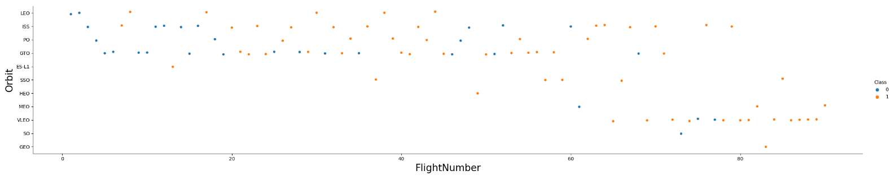
Flight Number vs. Orbit Type
Blue indicates unsuccessful launch while orange indicates successful launches.
Launch Orbit preferences changed over Flight Number. Launch Outcome seems to correlate with this preference.
SpaceX started with LEO orbits which saw moderate success LEO and returned to VLEO in recent launches SpaceX appears to perform better in lower orbits or Sun-synchronous orbits

Slide 22
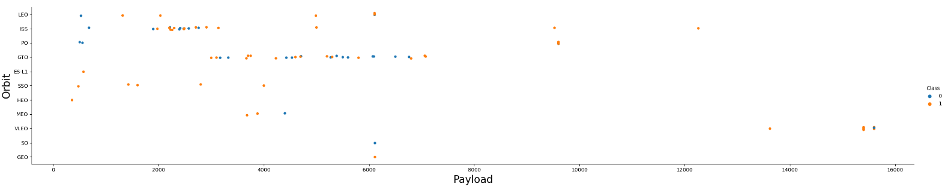
Payload vs. Orbit Type
Blue indicates unsuccessful launch while orange indicates successful launches.
Payload mass seems to correlate with orbit
LEO and SSO seem to have relatively low payload mass
The other most successful orbit VLEO only has payload mass values in the higher end of the range

Slide 23
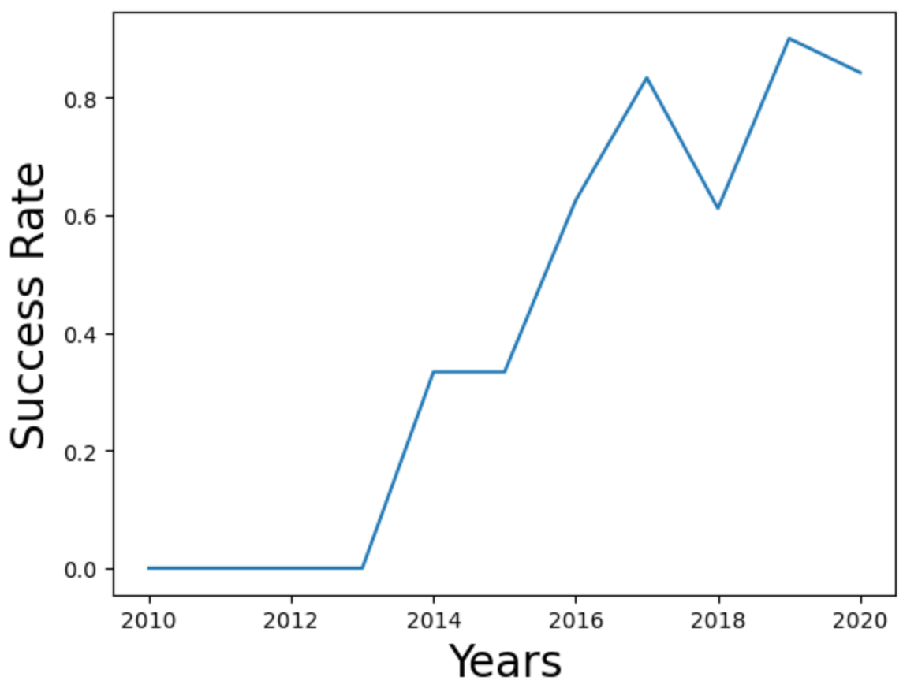
Launch Success Yearly Trend
Success generally increases over time since 2013 with a slight dip in 2018
Success in recent years at around 80%

Slide 24
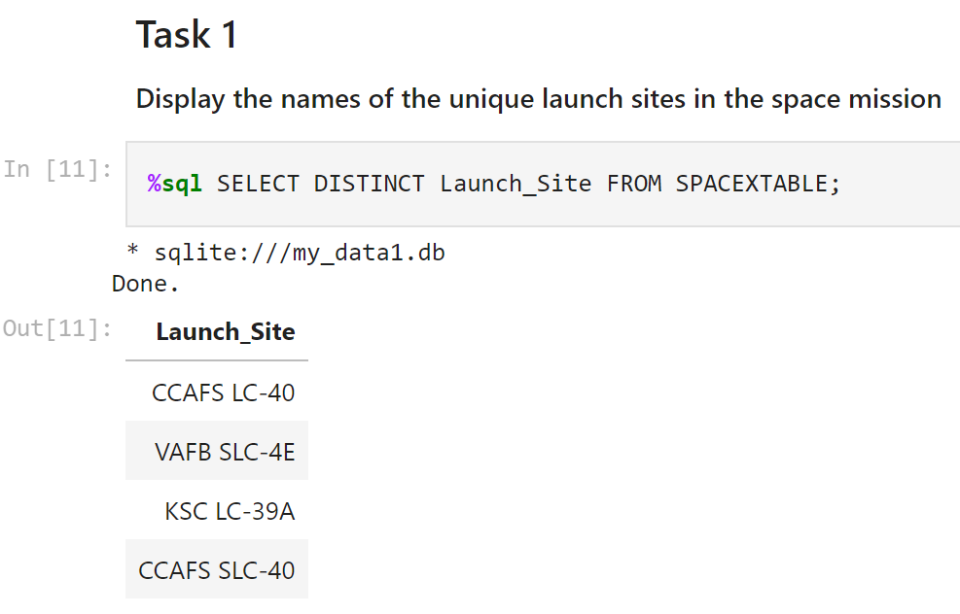
All Launch Site Names
CCAFS SLC-40 and CCAFS LC-40 are the same site either entered incorrectly or the name changed.

Slide 25
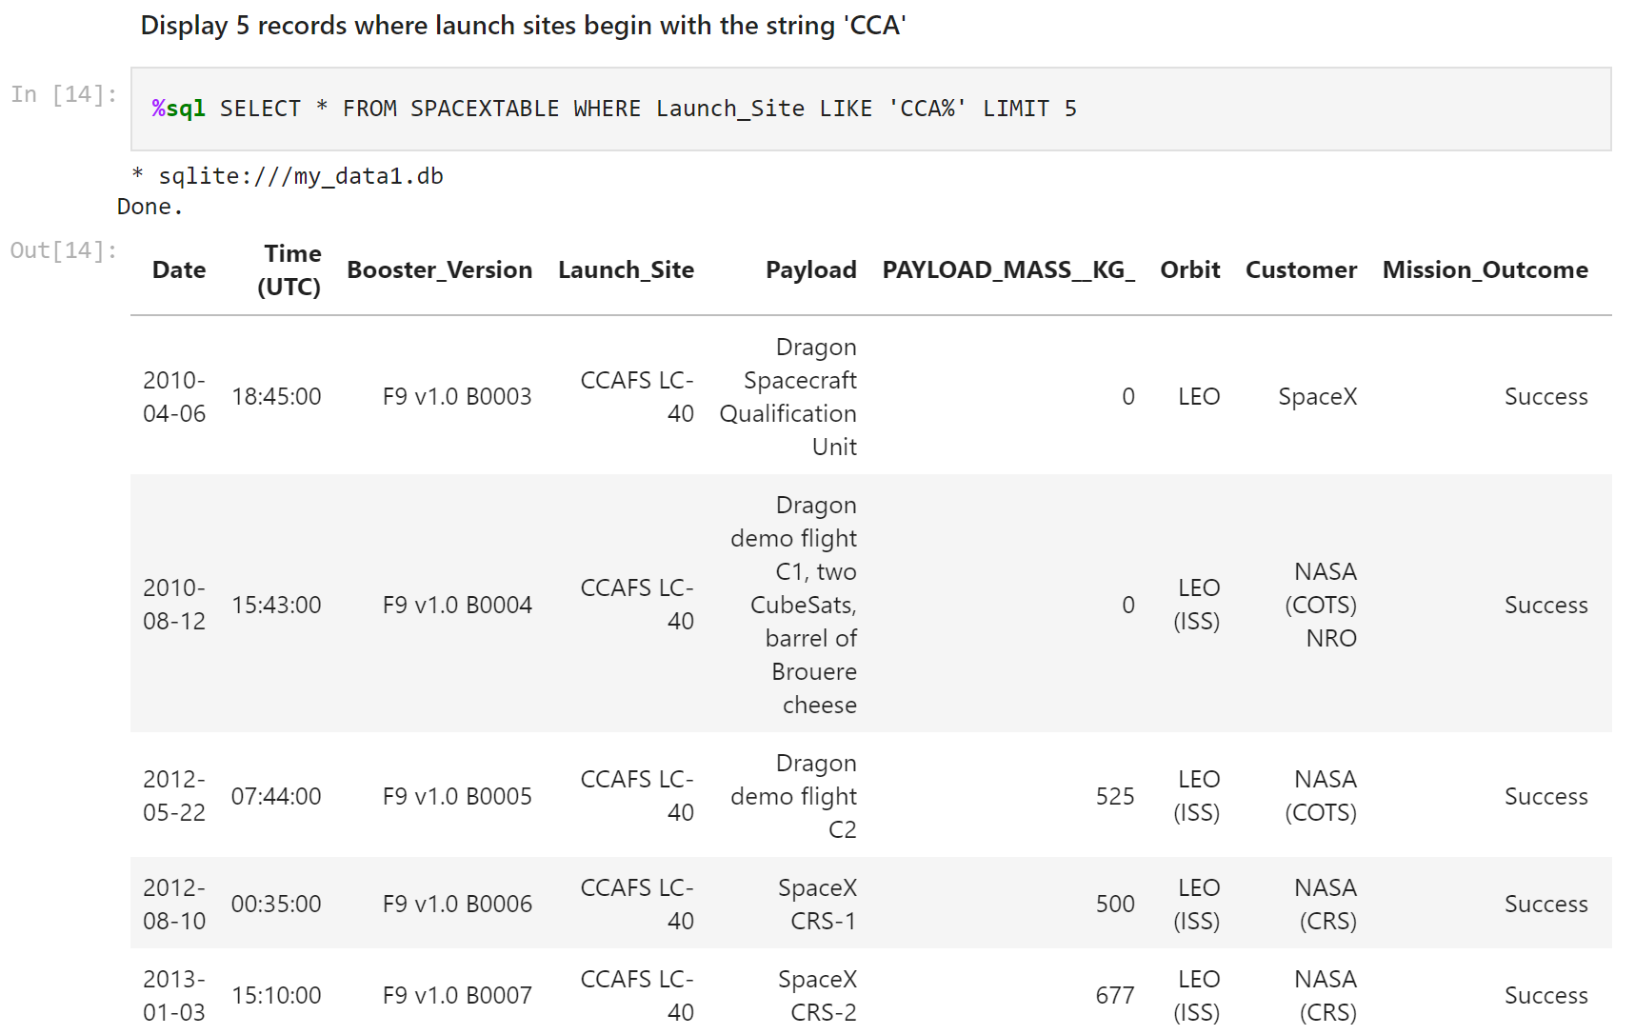
Launch Site Names Begin with 'CCA'
Each record uses the launch site that begins with ‘CCA’

Slide 26
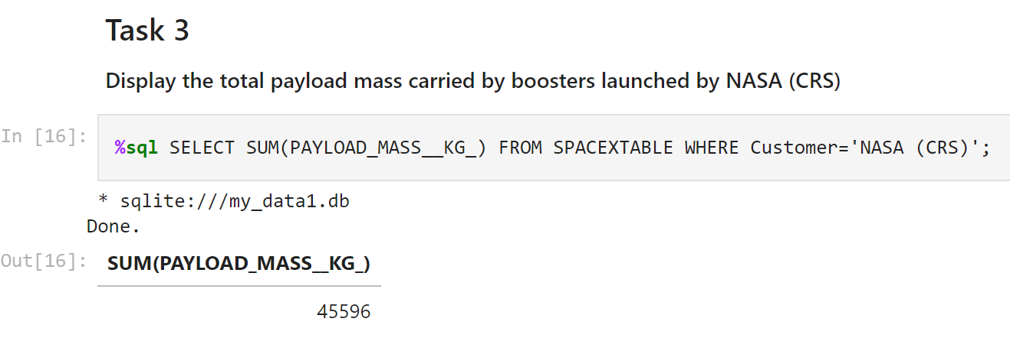
Total Payload Mass
Mass payload was calculated by summing the column labeled PAYLOAD_MASS__KG_

Slide 27
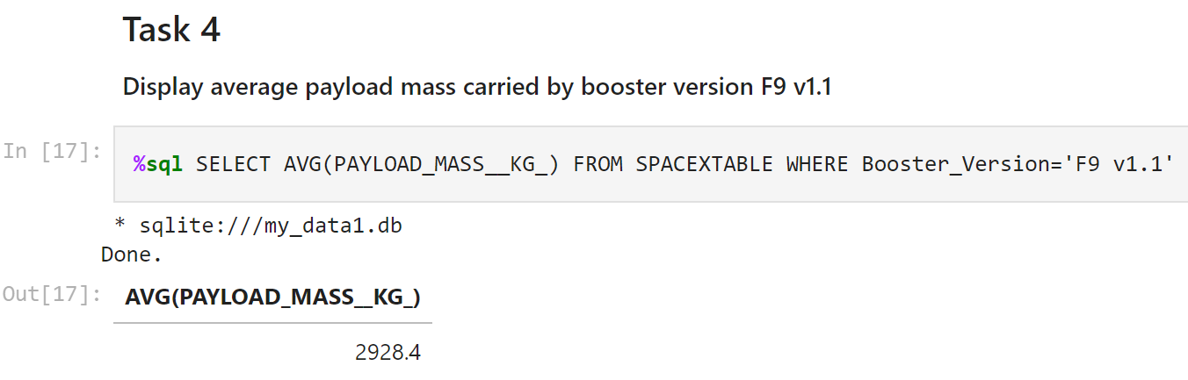
Average Payload Mass by F9 v1.1
Average Payload Mass was calculated by taking the average of the PAYLOAD_MASS__KG_ column sorted by the specific booster type of F9 v1.1

Slide 28
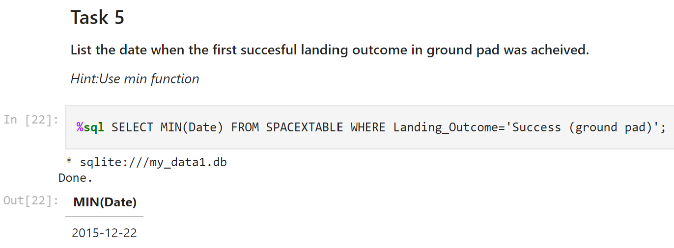
First Successful Ground Landing Date
The minimum date was selected from the Date column in order to obtain the first date where a rocket landed on a ground pad successfully.

Slide 29
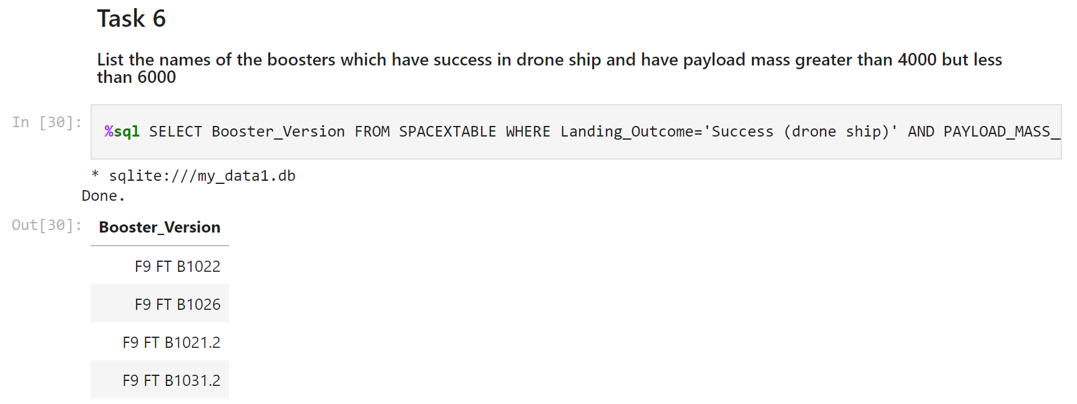
Successful Drone Ship Landing with Payload between 4000 and 6000
The query uses two where parameters that take in the success type and the payload mass drawing the Booster_Versions that had a payload mass between 4000 and 6000 KG and had a successful landing on a drone ship.

Slide 30
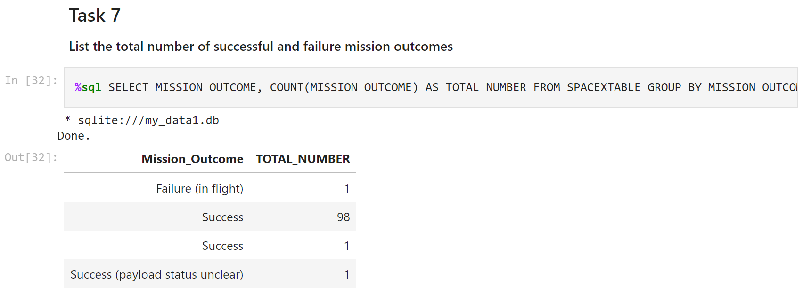
Total Number of Successful and Failure Mission Outcomes
Mission outcome types and the number of those missions were returned.

Slide 31
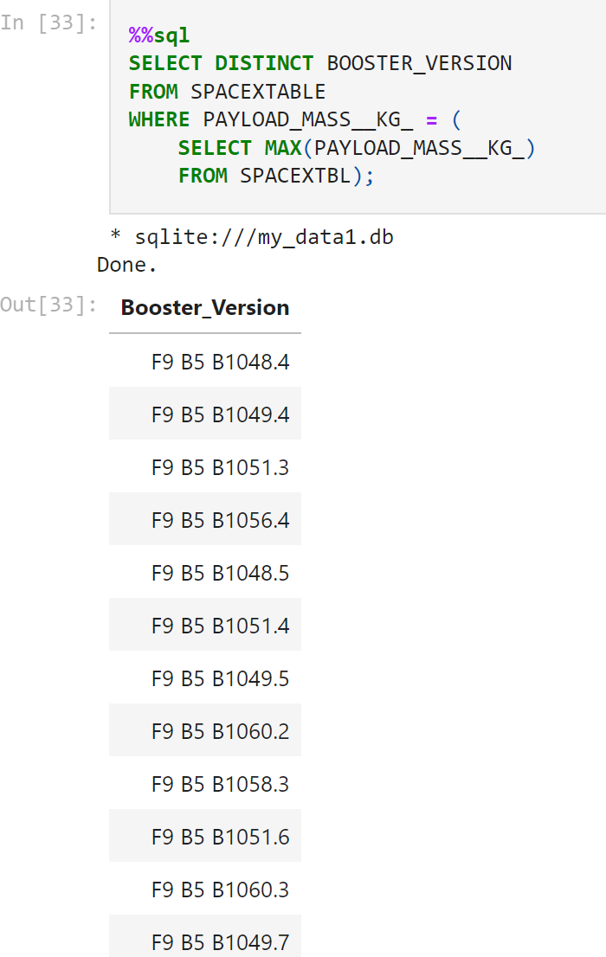
Boosters Carried Maximum Payload
Using a subquery, max payload mass and is able to sort Booster version into the boosters that have transported the max payload mass.

Slide 32
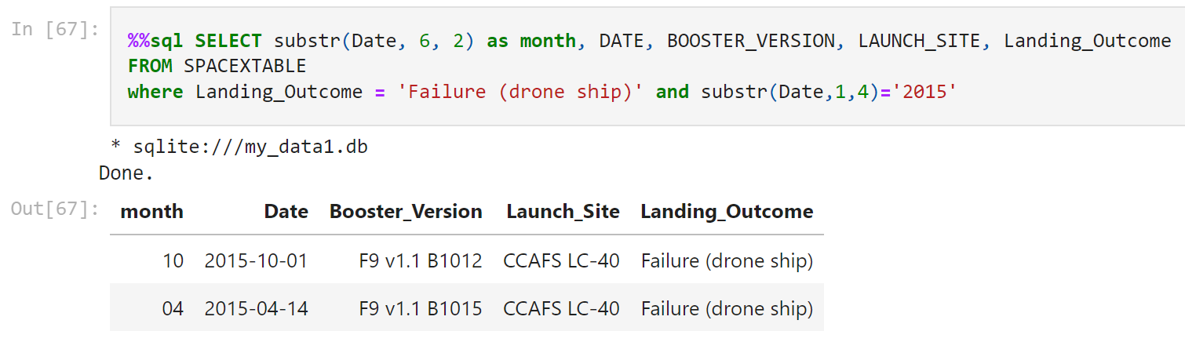
2015 Launch Records
This gives the month, date, booster version, launch site for landing outcomes that were a failure with drone ship landings.

Slide 33
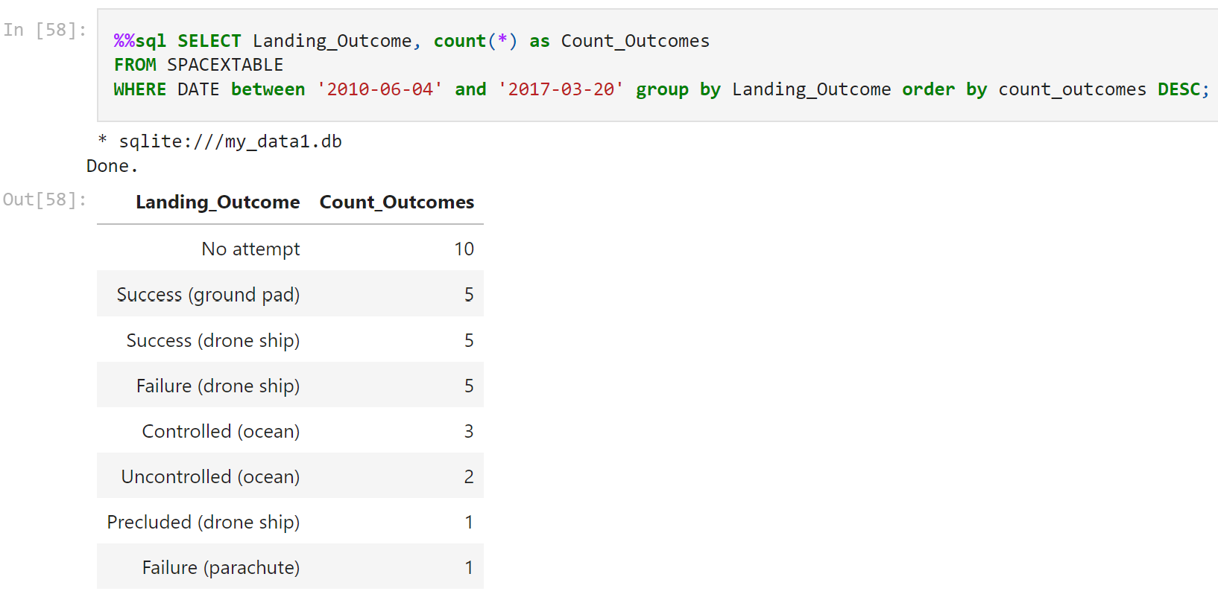
Rank Landing Outcomes Between 2010-06-04 and 2017-03-20
This shows the count of landing outcomes for the time period between 6-4-2010 and 3-20-2017. No attempt was the highest, showing that most landings were not attempted during this time.

Slide 34

Section 3

Slide 35
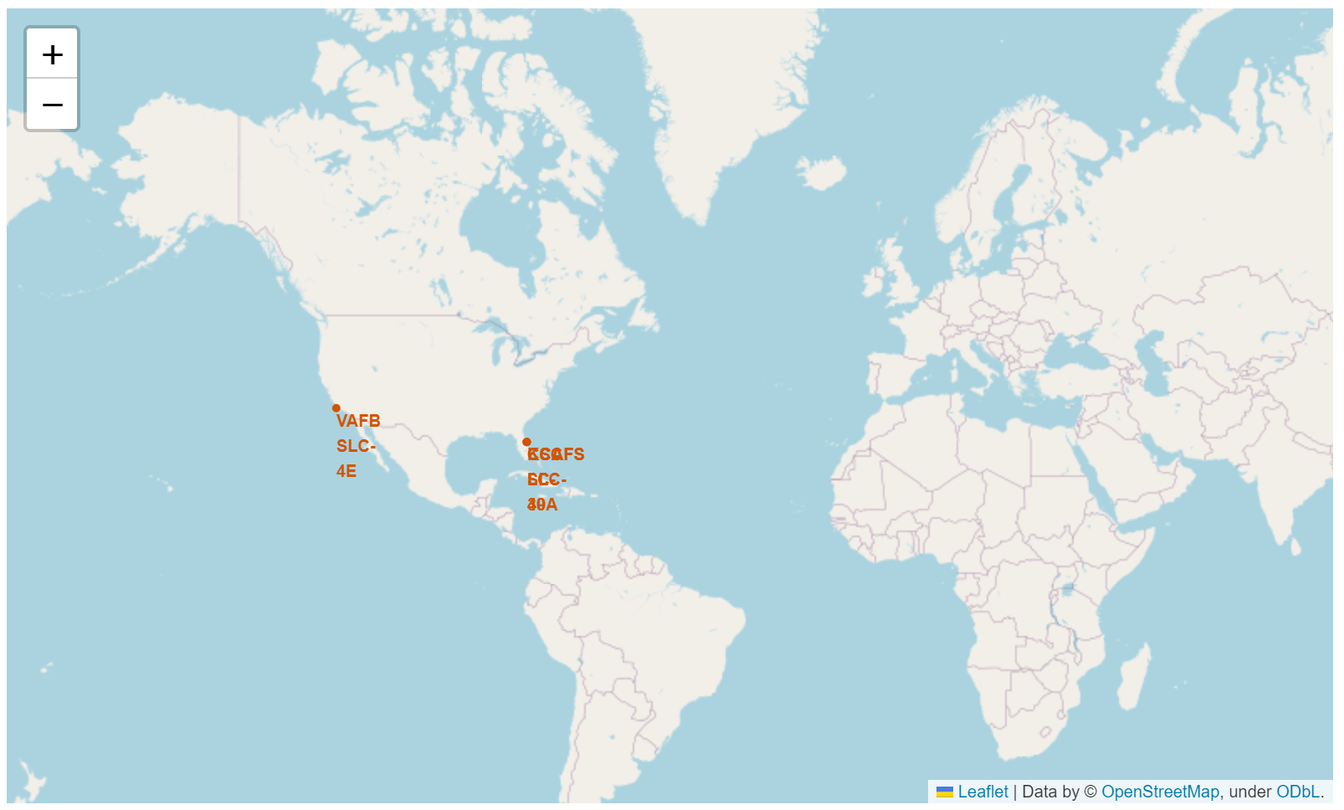
Launch Site Locations
All SpaceX launches are made from the United States in primarily Florida and California coastal areas.

Slide 36
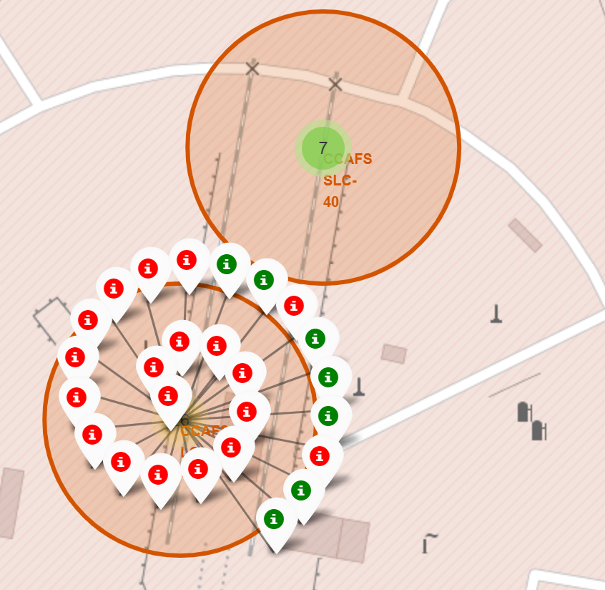
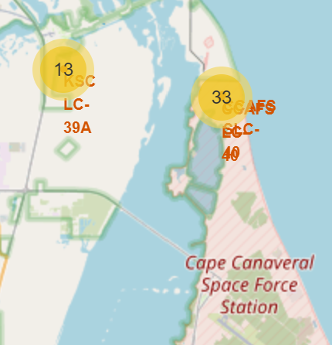
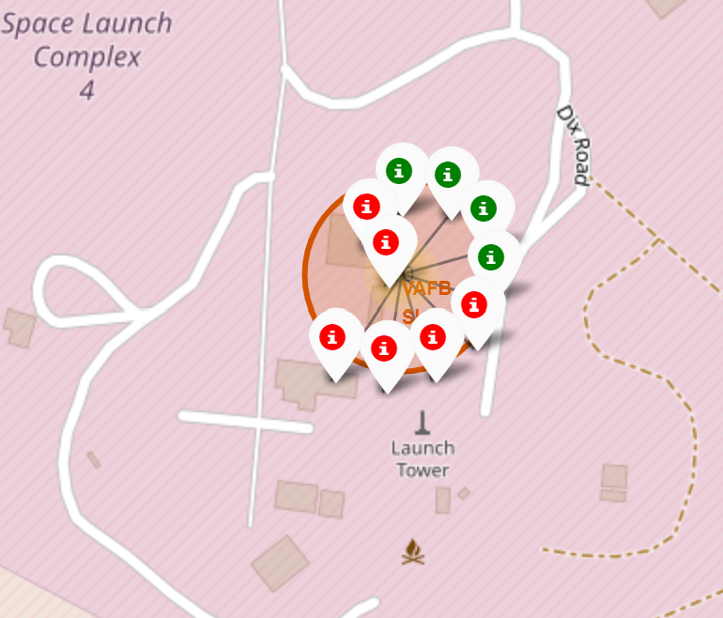
Color Code Launch Markers
Clusters on Folium map can be clicked on to display each successful landing (green icon) and failed landing (red icon). The Yellow circles near Cape Canaveral launch sites indicate the launch sites and the number of launches performed there.

Slide 37
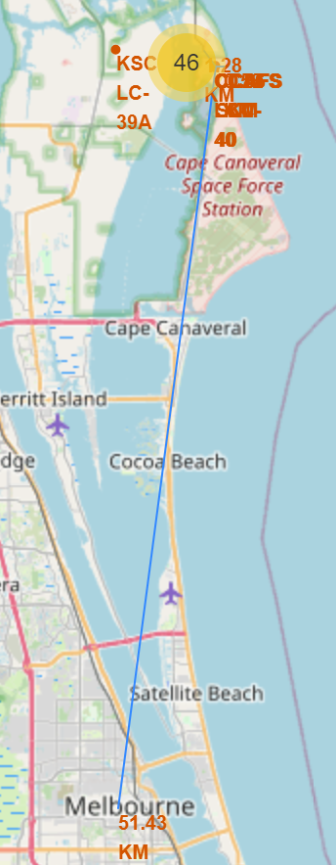
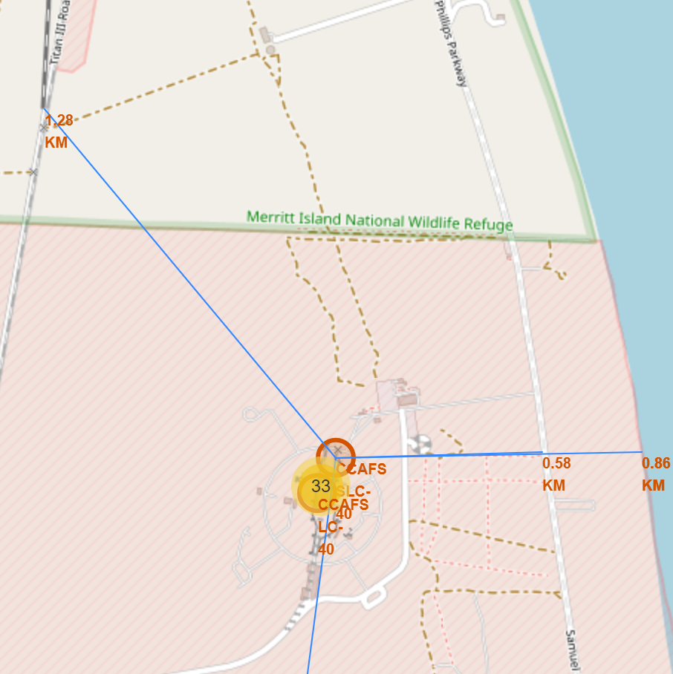
Launch Site Distance to Land Markers
Here is an example of the map performing a distance calculation to the city of Melbourne, FL from CCAFS SLC – 40.
Here we can see this function working closer to CCAFS SLC – 40. It shows the distance to local railroads, highways, and the coast.

Slide 38

Section 4

Slide 39
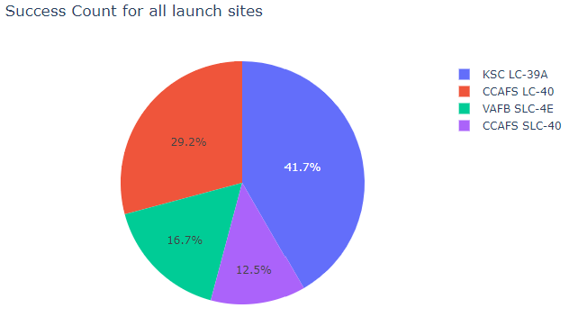
Success Count for All Launch Sites – Pie Charts
41.7% of Successful launches came from KSC LC-39A while only 12.5% of all successful launches came from CCAFS SLC-40.

Slide 40
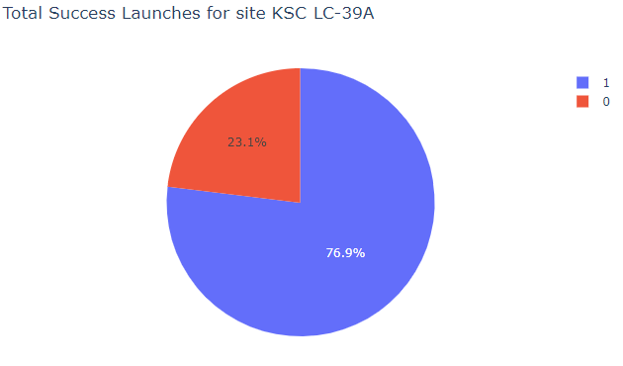
SpaceX Launch Success for Site KSC LC – 39A
76.9% of launches from KSC LC-39A were successful.

Slide 41
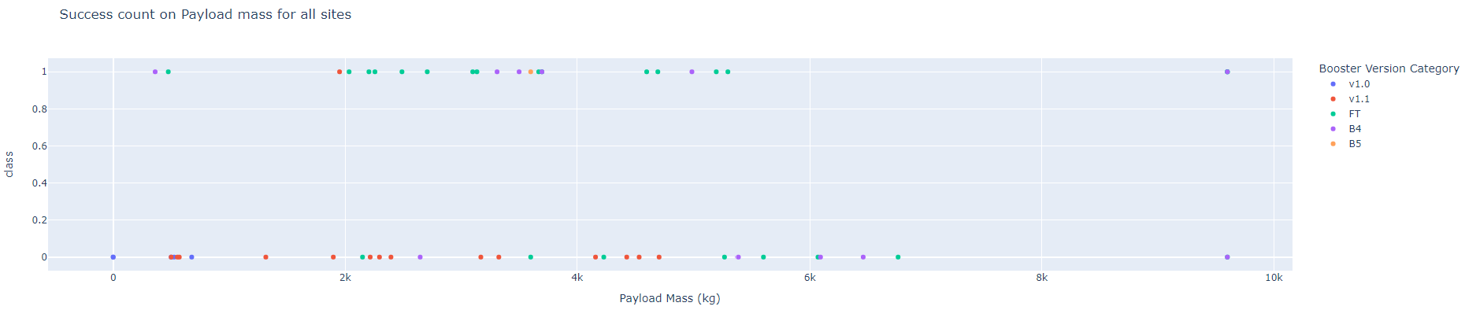
Successful Launches for All Launch Sites
Plotly dashboard has a Payload range selector. However, this is set from 0-10000 instead of the max Payload of 15600. Class indicates 1 for successful landing and 0 for failure. Scatter plot also accounts for booster version category in color and number of launches in point size. In this particular range of 0-6000, interestingly there are two failed landings with payloads of zero kg.

Slide 42

Section 5

Slide 43
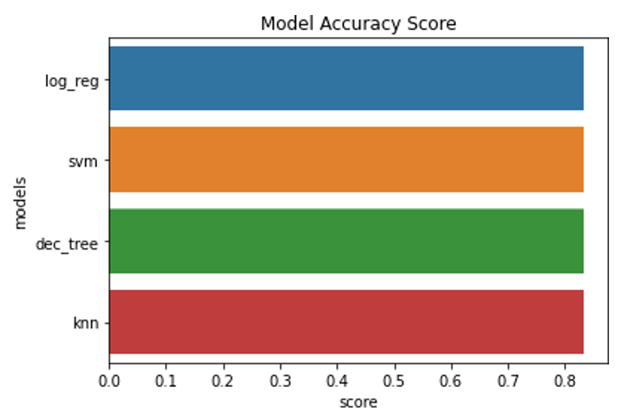
Classification Accuracy
Each model had virtually the same accuracy of 83.33%. Likely due to the small sample size of only 18.

Slide 44
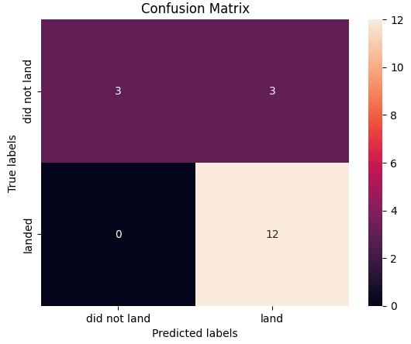
Confusion Matrix
Since all models performed the same for the test set, the confusion matrix is the same across all models. The models predicted 12 successful landings when the true label was successful landing, 3 unsuccessful landings when the true label was unsuccessful landings, 3 successful landings when the true label was unsuccessful landings (false positives). The models over predicted landings.

Slide 45
Conclusions
Task: to develop a machine learning model for Space Y – a company trying to out perform SpaceX
The goal of the model is to predict when Stage 1 will successfully land to save approx. $100 million.
Using data from public SpaceX API and web scraping SpaceX Wikipedia page:
Created data labels and stored data into a SQL database
Created a dashboard for visualization
created a machine learning model with an accuracy of 83%
SpaceY can use this model to predict with relatively high accuracy whether a launch will have a successful Stage 1 landing before launch to determine whether the launch should be made or not
Since this model was built off a small data set, more data should be collected to determine the best model to use to have a higher accuracy of predictability.

Slide 46
Appendix
GitHub Respository for Capstone
https://github.com/AKingSolutions/IBM-Data-Science-Certification-Capstone
Thanks to All Instructors!

Slide 47


